Slide 1
Campus Radio App
An Fully Featured Android Radio App
By
Ajoy Das
BUET_Shikkanobish
CSE, BUET

Slide 2
Campus Radios in Bangladesh:
Bangladesh University of Engineering & Technology
University of Dhaka
Chittagong University of Engineering & Technology
Sylhet Engineering College - SEC
University of Liberal Arts Bangladesh
Daffodil International University
Northern University Bangladesh, NUB
Ahsanullah University of Science and Technology
And some others….

Slide 3
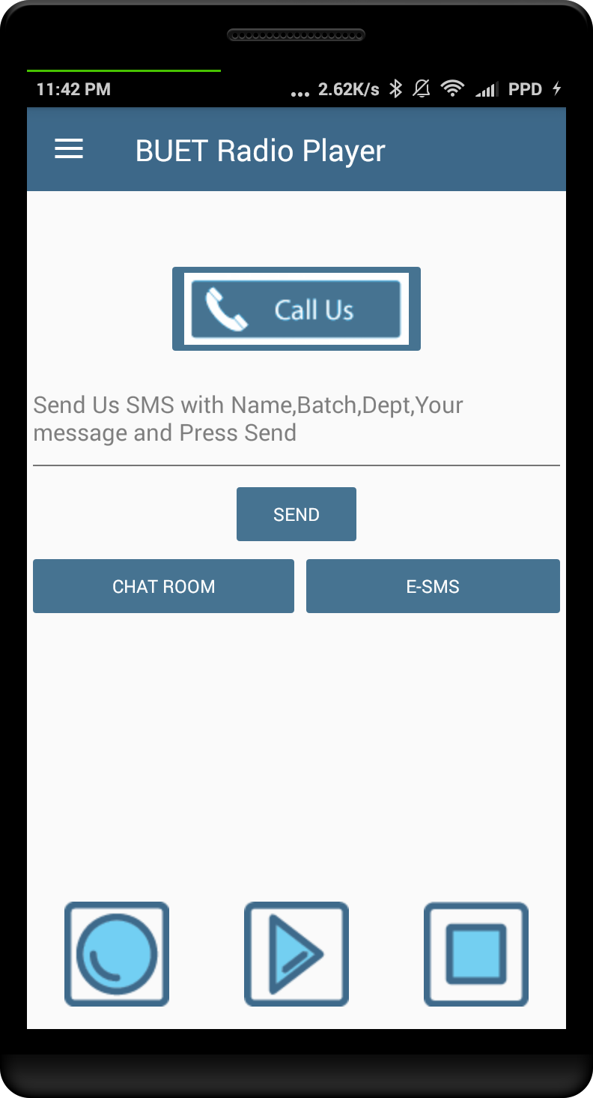
Features:
Player:
With recording, calling & sending SMS feature.

Slide 4
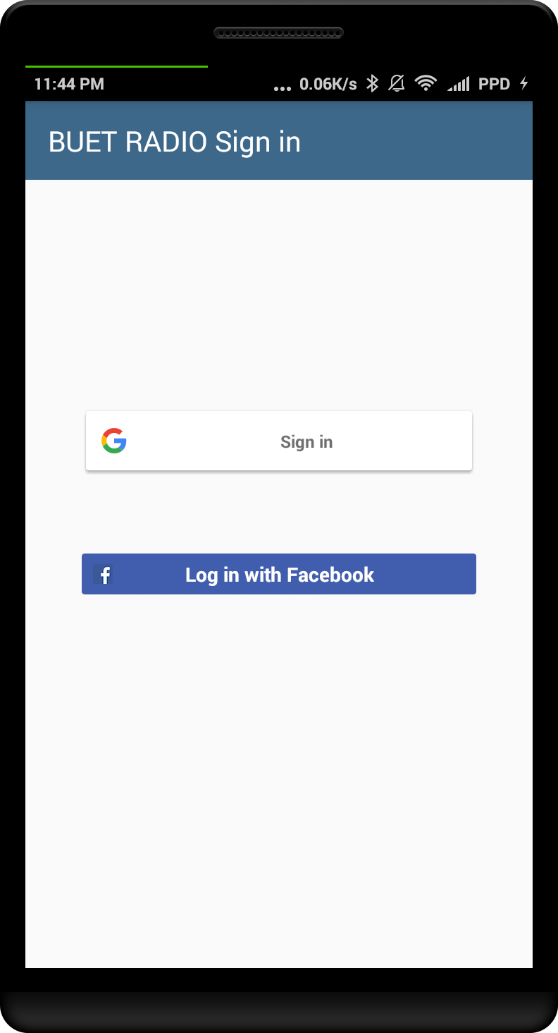
Features:
Sign In:
With Google or Facebook & Connect to the community.

Slide 5
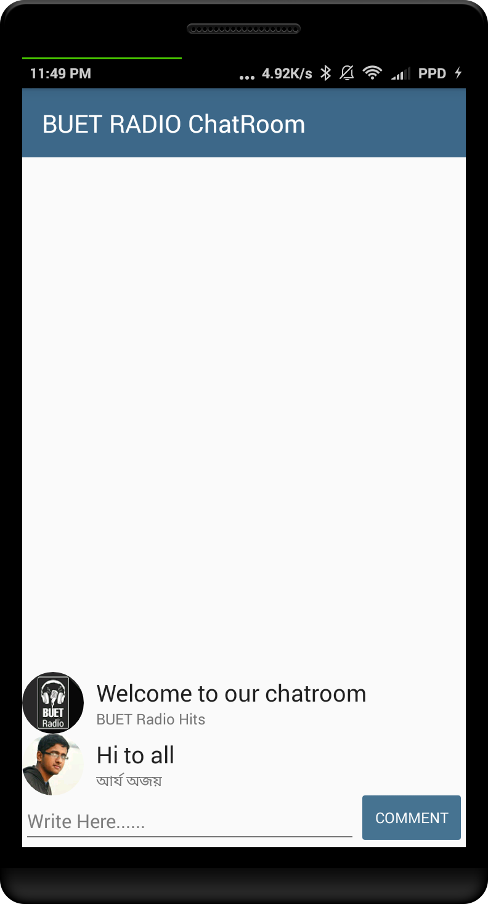
Features:
Chatroom:
Chat with Campus Radio Community and share your feelings.
Real time database is used.

Slide 6
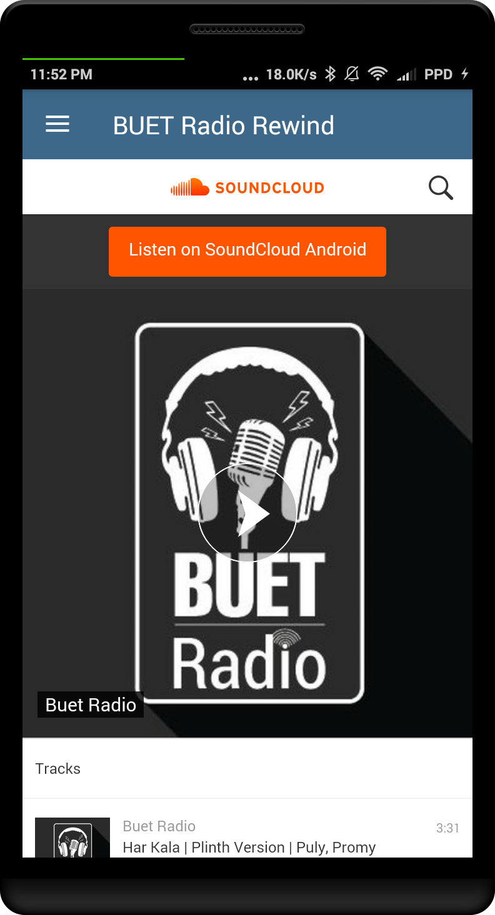
Features:
Rewind:
Rewind the archive from SoundCloud & website.

Slide 7
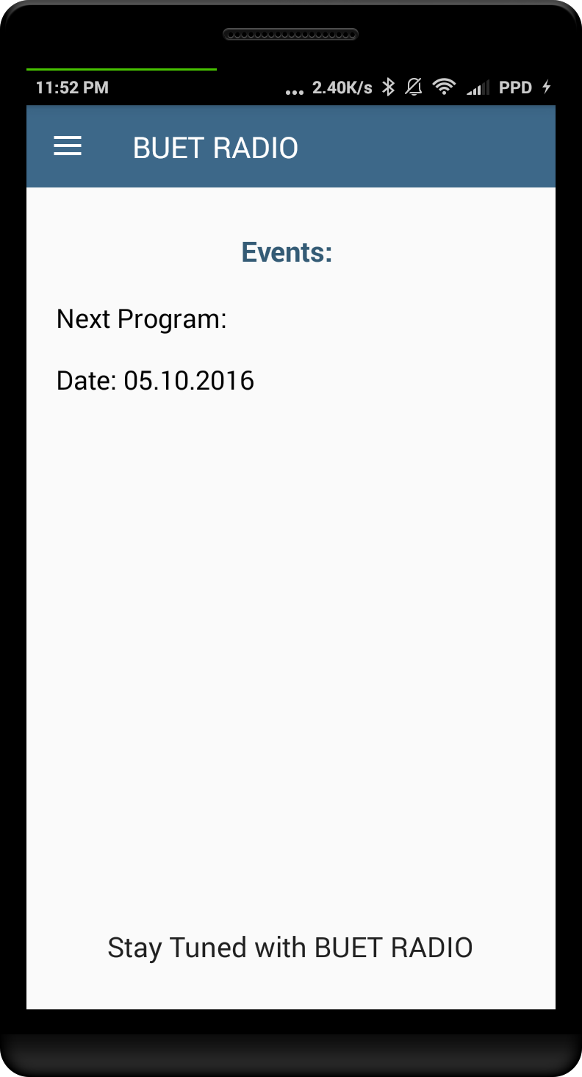
Features:
Events:
Get the events details from the app.

Slide 8
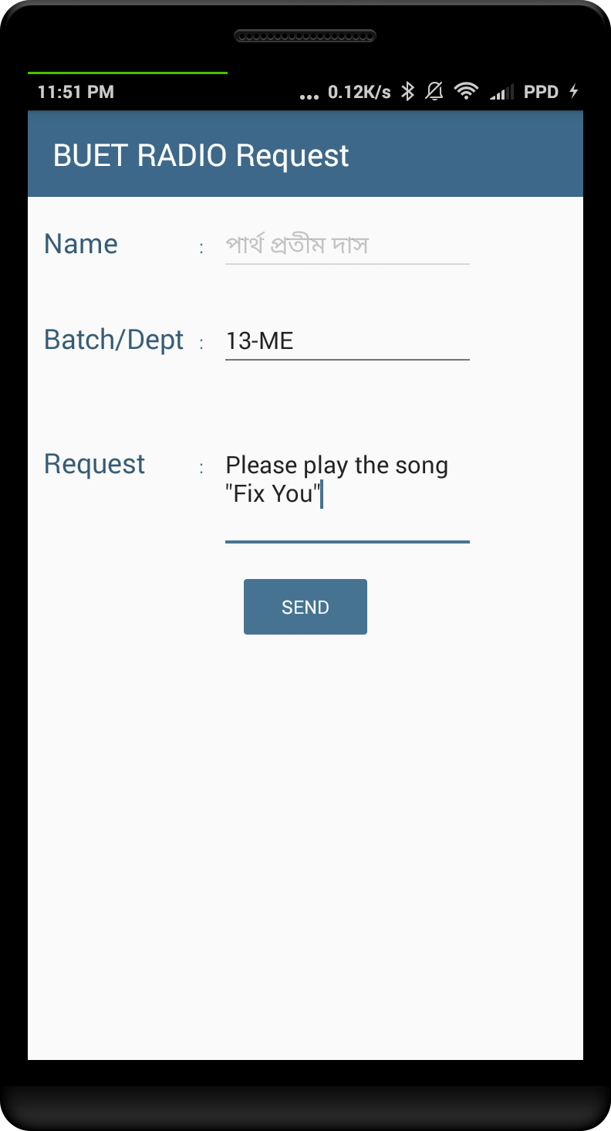
Features:
eSMS:
Send SMS even if you are out of balance.

Slide 9
Features:
Notification:
Know about the events through notifications.
Remote Configuration:
Change servers and contacts remotely.
Crash Reporting:
Know about the bugs and crashes from firebase consol.

